Slide 1







MGMT 6058
Module 6
Exercises
Do the exercise
prior to next slide
Videos
Solution
Slide
PPT
Animations
Project Scheduling:
Gantt Charts
Exercise
Simulation
M6 EXERCISE Gantt project planner V1.xlsx
M6 Project Delta Gantt Chart.mpp
Review Exercise
Printout
M6 EXCEL DIGITAL or HANDOUT Project PERT Dur.xlsx
Use
Excel
See text in “slide note” for more details
M6 Student Critical Path Merge Bias Simulator V2.xlsx
Use
Excel

Slide 2
Module 6 Learning Objectives
Critical Path Merge Bias and a Monte Carlo simulation
Understand the basics of Gantt Charts
Compare the similarities of Gantt Charts in Excel and MS Project
But first a mini review from previous modules
Calculating Project Standard Deviation
Activity Relationships
AOA Diagrams

Slide 3
Mini Review from previous modules
Calculating Project Standard Deviation
Activity Relationships
AOA Diagrams

Slide 4
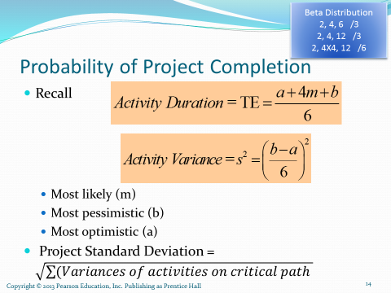
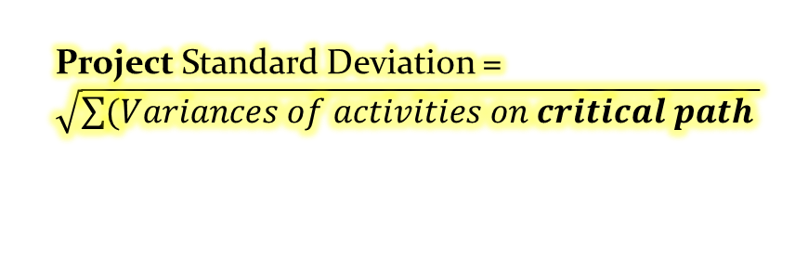
Review Exercise, Probabilities of Project Durations
Let’s calculate the likelihood of a simple project meeting a deadline
Let’s look at PERT bias sometimes called PERT merge bias
Project Standard Deviation = $\sqrt{\sum{(Variances of activities on critical path }}$
Printout
M6 EXCEL DIGITAL or HANDOUT Project PERT Dur.xlsx
Use
Excel

Slide 5
Project Duration and Critical Path Merge Bias
In the last slide we calculated the project duration of a simple project using the longest path, the critical path
Let’s look at critical path merge bias
When we calculate the critical path, we have been using a fixed estimate (e.g. TE from PERT) for the duration of the activities.
In reality, there is statistical variability of each activity, which we see when we used O, M, and P estimates.
And the actual durations of the project are frequently different than our original estimates.
Because of these factors, what was a shorter path (not critical) can become a critical path because some of the activities were longer than our original fixed estimate.

Slide 6
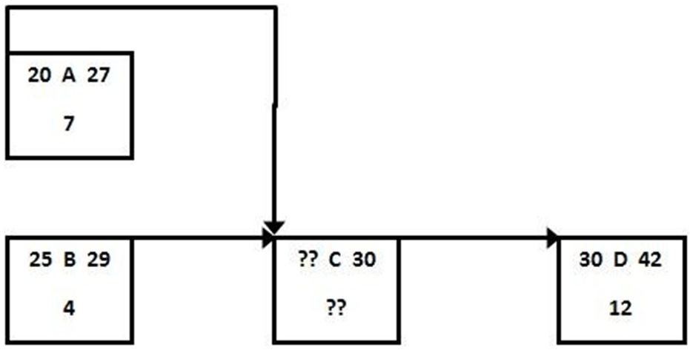
What is the early start time for activity C?
A) day 20
B) day 25
C) day 27
D) day 29

Slide 7
What is the early start time for activity C if it has the start to start relationship shown?
A) day 20
B) day 25
C) day 27
D) day 29
Answer is D

Slide 8
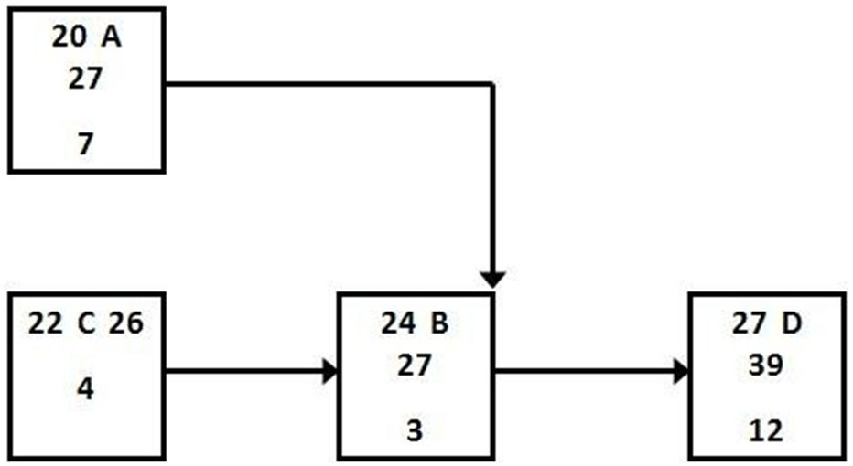
Activity A and B have a finish to finish relationship and early start and finish times as shown. What is the result of incorporating a 4-day lag between activities A and B?
A) The early finish for A increases to 31.
B) The early start time for A increases to 24.
C) The early finish time for B increases to 31.
D) The early start time for D falls to 23
20
24
Part 2
What if the 4-day lag is actually located between activities B and D, what is the EF for D?

Slide 9
Activity A and B have a finish to finish relationship and early start and finish times as shown. What is the result of incorporating a 4-day lag between activities A and B?
A) The early finish for A increases to 31.
B) The early start time for A increases to 24.
C) The early finish time for B increases to 31.
D) The early start time for D falls to 23
Answer is C
20
24
What if the 4-day lag is actually located between activities B and D, what is the EF for D?
Answer is 43

Slide 10
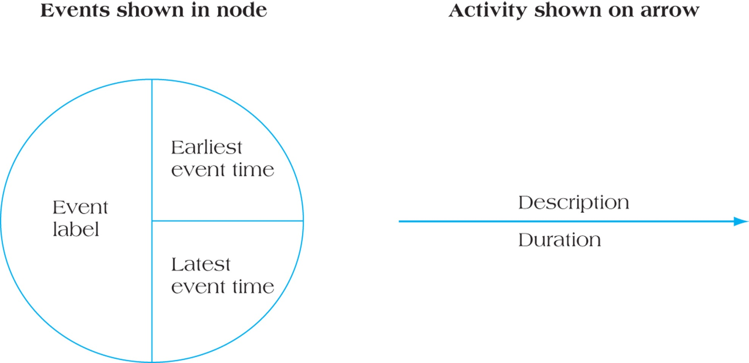
Notation for Activity-on-Arrow (AOA) Networks
Figure 10.18

Slide 11
Review the AOA Slides in Module 5 Before Proceeding

Slide 12
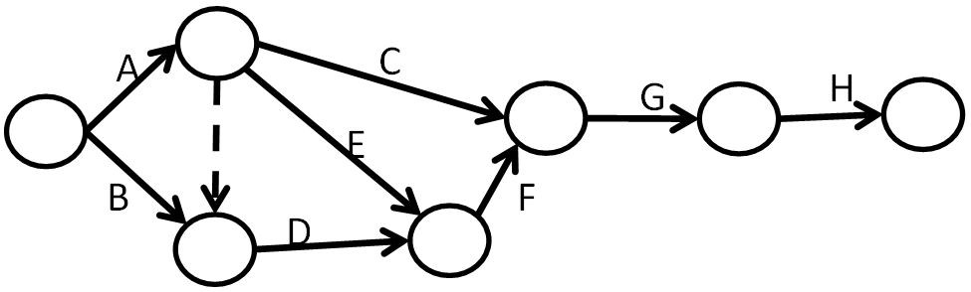
New AOA Project
Kira has a project consisting of eight activities as listed in the table (with durations in days). They assigned the intern Mick to sketch a network diagram in AOA and Mick produced the sketch shown below.
Activity | Activity Duration | Pre-decessor
A | 6
B | 8
C | 5 | A
D | 9 | A, B
E | 12 | A
F | 11 | E, D
G | 6 | C, F
H | 3 | G
Draw a diagram with the early and late event times for all of the activities. What is the critical path?
0
0
Use a piece of paper for this exercise

Slide 13
AOA - Determine the early and late event times for all of the activities
Activity | Activity Duration | Pre-decessor
A | 6
B | 8
C | 5 | A
D | 9 | A, B
E | 12 | A
F | 11 | E, D
G | 6 | C, F
H | 3 | G
6
Where is the critical path?
6
6
5
29
35
38
0
29
35
38
0
6
3
12
The critical path is A,E,F,G,H.
Note, only this event has a different “latest event time” --all other events are on the critical path, but Activity B, D, and also C -- are not on the critical path.
8
8
18
11
9
9
18

Slide 14
Module 6 Gantt Charts and
Critical Path Merge Bias
Critical Path Merge Bias and a Monte Carlo simulation
Understand the basics of Gantt Charts
Compare the similarities of Gantt Charts in Excel and MS Project

Slide 15
Project Duration and Critical Path Merge Bias
We’ll use a project with a simple AON diagram to demonstrate critical path merge bias. A single start activity S, then 3 parallel activities (A,B,C) and a single finish activity F. Activity A is on the critical path.
Activity Name | Duration | Std Dev | Note
Start Activity S | 4.00 | 0.50
Activity A (longest) | 19.00 | 1.50 | Activities A, B, & C are parallel
Activity B | 18.00 | 3.50
Activity C | 17.00 | 3.50
Finish Activity F | 2.00 | 0.50
Activity A
Start Activity S
Activity B
Finish Activity F
Activity C
But if we drew the O to P range (using 6 Std Dev) of Activity A, B & C, it would look like this. Although the longest duration is A at 19 days, you can see that sometimes B and C would be longer.
O
19d
P
Activity A
O
18d
P
Start Activity S
Finish Activity F
Activity B
O
17d
P
Activity C

Slide 16
Project Duration and Critical Path Merge Bias
Activity Name | Duration | Std Dev | Note
Start Activity S | 4.00 | 0.50
Activity A (longest) | 19.00 | 1.50 | Activities A, B, & C are parallel
Activity B | 18.00 | 3.50
Activity C | 17.00 | 3.50
Finish Activity F | 2.00 | 0.50
Let’s use a Monte Carlo simulation in Excel, to demonstrate critical path merge bias.
Open the Excel file below and enter the Activity
Duration and Std Dev information in the table above
into the yellow cells in the Excel file.
Three durations are created:
  the longest path
  random durations based on the longest path and the SD of the longest path
  and a simulation that uses the SD’s of the activities but takes the longest duration of A, B, and C in each simulation run (there are 200 “runs”)
Look at the simulation to figure out how it is calculating the project duration.
Press F9 repeatedly and observe the difference between the average random vs simulation durations, and the difference in the duration ranges.
We’re using a simple Monte Carlo simulation, compare the 2 bar-charts in the following link https://www.riskamp.com/monte-carlo-simulation-in-project-planning
M6 Student Critical Path Merge Bias Simulator V2.xlsx
Use
Excel

Slide 17
Gantt Charts
Establish a time-phased network
Can be used as a tracking tool
Benefits of Gantt charts
Easy to create and comprehend
Identify the schedule baseline network
Allow for updating and control
Can help identify resource needs
6 Benefits of Creating a Gantt Chart for Your Next Project (3 min)
https://www.youtube.com/watch?v=UceR9-aJblo

Slide 18
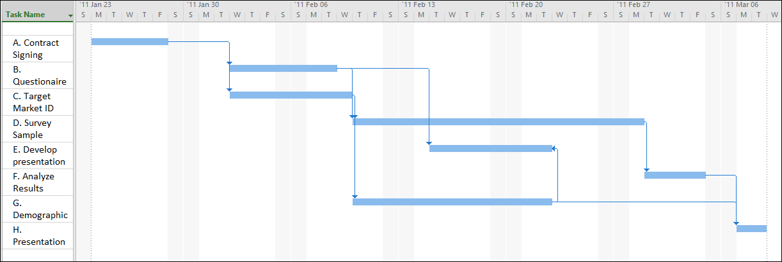
Gantt Chart with Lag & FF Relationships
#1 –Where are Activities with lags?
#2- Using only the graphical bar, what is the duration of Activity E?
#3 –Where is the FF relationship?
Make sure you can “read” weekends on a Gantt Chart and how they affect or don’t, duration. In this Gantt Chart we are not working weekends.

Slide 19
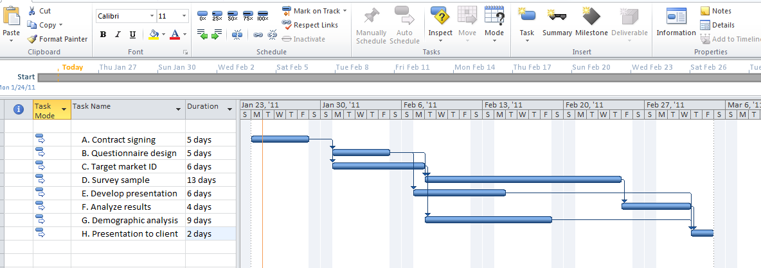
Completed Gantt Chart for Project Delta
MS Project Exercise
Figure 10.8
Open the MS Project file and click on “Gantt” View.
M6 Project Delta Gantt Chart.mpp

Slide 20
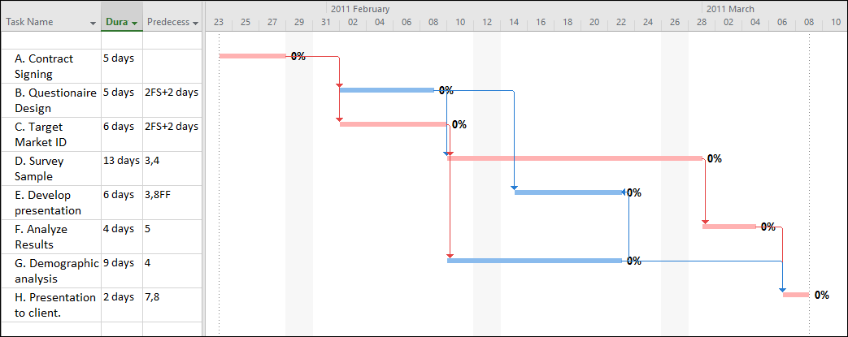
Gantt Chart for Project Delta with Critical Path Highlighted
Click on “Tracking Gantt” View.
What does the 0% mean?
Why are some tasks blue and some “red”?
Why does it look like there is a lag in the Gantt between F and H, but no lag in predecessor column?
Notes:
0% indicates 0% complete. Work may have been performed on an activity but it may still be 0% complete, nothing has been accomplished, no “work” (as in measureable work, not effort, has been performed).
The “red” tasks are on the critical path.
There is no lag between F and H, there is a weekend but it’s not showing on the Gantt Chart. MS Project is only showing every 2nd weekend which is misleading.

Slide 21
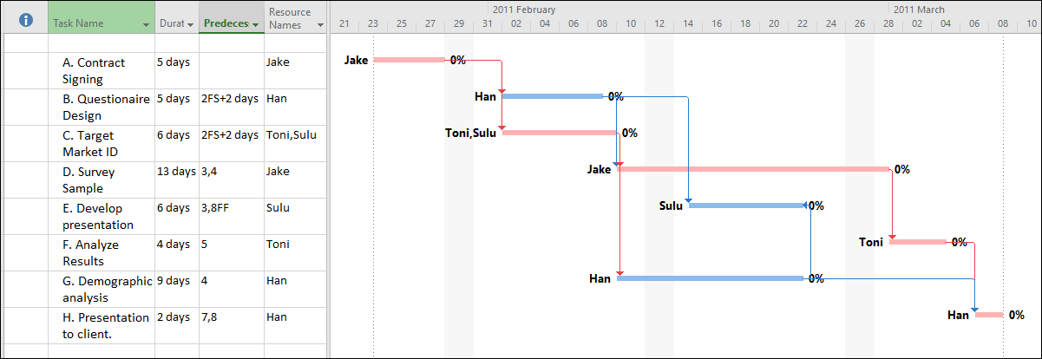
Gantt Chart with Resources Allocated
Let’s add some resources to our M6 Project Delta Gantt Chart.mpp file, by using the Resource Name column, -- or by double clicking each activity and using the “Resources” tab and then clicking on a cell(s) below “Resource Name”

Slide 22
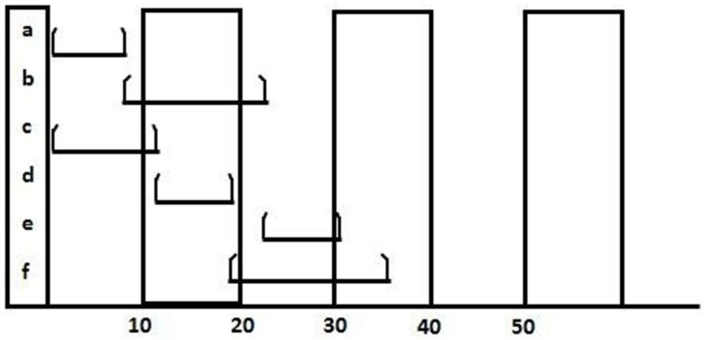
Which statement about this Gantt chart is best?
A) Activity a has a duration that could be as short as 1 day but no longer than 8.
B) Activity b probably has activity a as a predecessor.
C) No progress has been made on activity d.
D) Activity c is the longest activity.

Slide 23
Which statement about this Gantt chart is best?
A) Activity a has a duration that could be as short as 1 day but no longer than 8.
B) Activity b probably has activity a as a predecessor.
C) No progress has been made on activity d.
D) Activity c is the longest activity.
Answer B
Notes:
Activity a might be scheduled for an 8 day duration, but if it could have an actual or rescheduled duration of 1 day then why not greater than 8 days like 12 days?
Nothing in the chart indicates progress is being tracked.
Activity c is a bit more than 10 days, maybe 11 or 12, but activity f is 15 or 16.
B) There is a good chance that activity b has activity a as a predecessor, and since the other answers are not correct, this is the best answer.

Slide 24
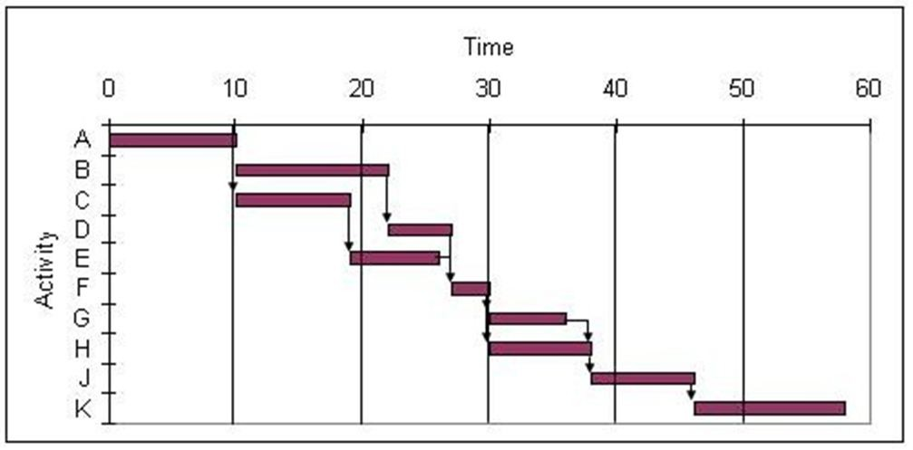
Use the Gantt chart and the activity list to determine when resource 5 is free.
Activity | Name of Resource |  | Activity | Name of Resource
A | 1 |  | F | 1
B | 5 |  | G | 2
C | 4 |  | H | 5
D | 3 |  | J | 3
E | 2 |  | K | 4
A) between 0 and 15
B) between 15 and 30
C) between 30 and 45
D) between 45 and 60

Slide 25
Use the Gantt chart and the activity list to determine when resource 5 is free.
Activity | Name of Resource | Activity | Name of Resource
A | 1 | F | 1
B | 5 | G | 2
C | 4 | H | 5
D | 3 | J | 3
E | 2 | K | 4
A) between 0 and 15
B) between 15 and 30
C) between 30 and 45
D) between 45 and 60
D) - Resource 5 is free 0-10 days, 22-30 and 37-60

Slide 26
Use the Gantt chart and the activity list to determine which resource is used the least.
A) Resource 1
B) Resource 3
C) Resource 4
D) Resource 2
E) Resource 5
Activity | Name of Resource | Activity | Name of Resource
A | 1 | F | 2
B | 1 | G | 3
C | 4 | H | 4
D | 2 | J | 3
E | 2 | K | 5

Slide 27
Use the Gantt chart and the activity list to determine which resource is used the least.
A) Resource 1
B) Resource 3
C) Resource 4
D) Resource 2
E) Resource 5
Activity | Name of Resource | Activity | Name of Resource
A | 1 | F | 2
B | 1 | G | 3
C | 4 | H | 4
D | 2 | J | 3
E | 2 | K | 5
Answer E) Resource 5 is actually less than Resource 3 (K is less than G+J)

Slide 28
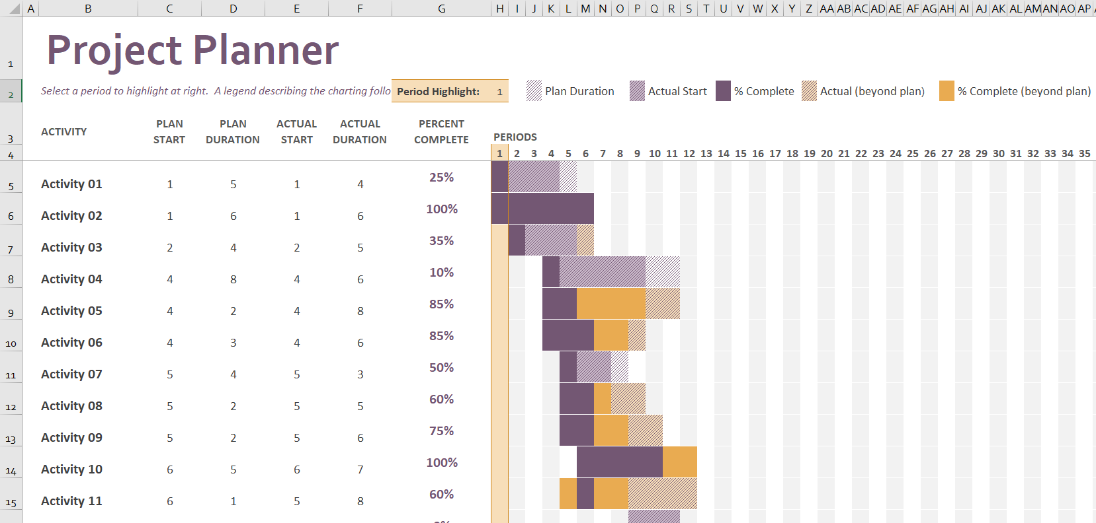

Excel and a Sophisticated Gantt Chart
Where are the dependencies?
What might we speculate about the dependencies?
Retrieved from Microsoft, https://templates.office.com/en-us/Gantt-project-planner-TM02887601
M6 EXERCISE Gantt project planner V1.xlsx
This is an extremely sophisticated example on using Excel for a Gantt chart. Open the file and experiment on how it works, but typically we would probably use something less complex in most projects.

Slide 29
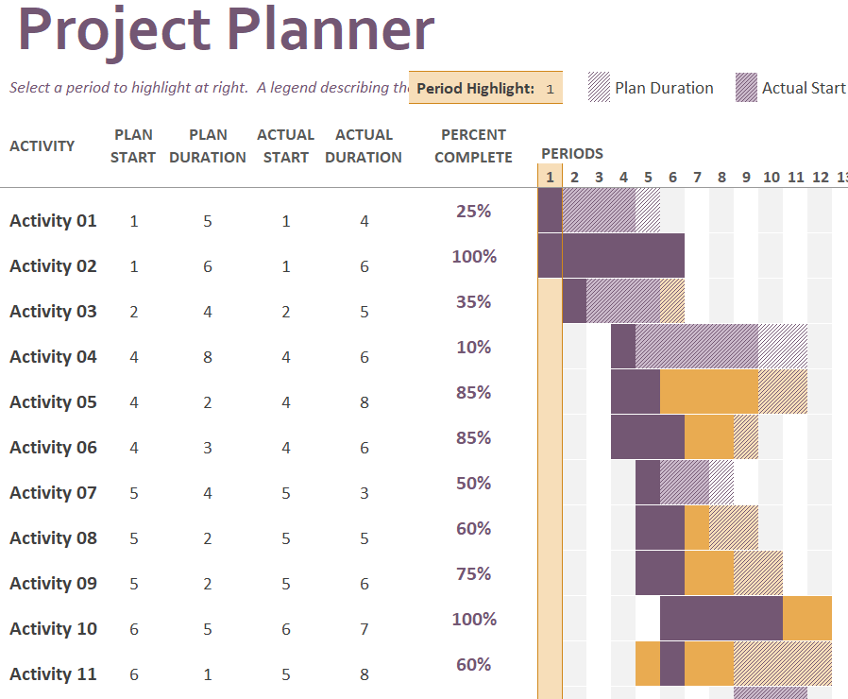
Excel and Gantt Charts
Retrieved from Microsoft, https://templates.office.com/en-us/Gantt-project-planner-TM02887601
This is an “extreme” example of an Excel Gantt Chart!
What does just dark purple mean?
This is only 35% complete, how do we know the “actual duration” is 5?
Actual (beyond plan) versus %Complete (beyond plan)?
Does this look 50% complete, why not?
This is complete, so why 2 colours?
Why is there orange on both sides of the purple?

Slide 30
Excel and Gantt Charts
Retrieved from Microsoft, https://templates.office.com/en-us/Gantt-project-planner-TM02887601
Retrieved from templates.office.com/en-us/Gantt-project-planner-TM02887601
#1 What does just dark purple mean?
#2 This is only 35% complete, how do we know the “actual duration” is 5?
#3 Actual (beyond plan) versus %Complete (beyond plan)?
#4 Does this look 50% complete, why not?
#5 This is complete, so why 2 colours?
#6 Why orange on both sides of the purple?
Notes:
NOTE: “Actual Start” means revised duration as of the start of the Activity
#1 -- 1 period out of 4 is complete, the 4 is the revised plan as of the Actual Start
#2 – If we are only 35% complete, then we haven’t finished, so how do we really know how long it will take? In this Excel file, Actual Duration also means Revised Duration (a new duration estimate).
#3 – We can increase our duration forecast for an activity, the amount of time we used of this increase is % Complete (beyond plan) and the amount of time we will probably use from the increase is Actual (beyond plan).
#4 – The duration decreased from 4 days to 3 days, but at 50%, that would be 1.5 days, however we can only show a full day or not a day, so we are rounding up and showing 2 days
#5 – We have the orange colour because we completed beyond the planned duration (we started on time)
#6 – We started a day early which shows Orange as we are technically beyond the plan, in this case early, which is still “beyond” the original plan
Retrieved from Microsoft, https://templates.office.com/en-us/Gantt-project-planner-TM02887601

Slide 31
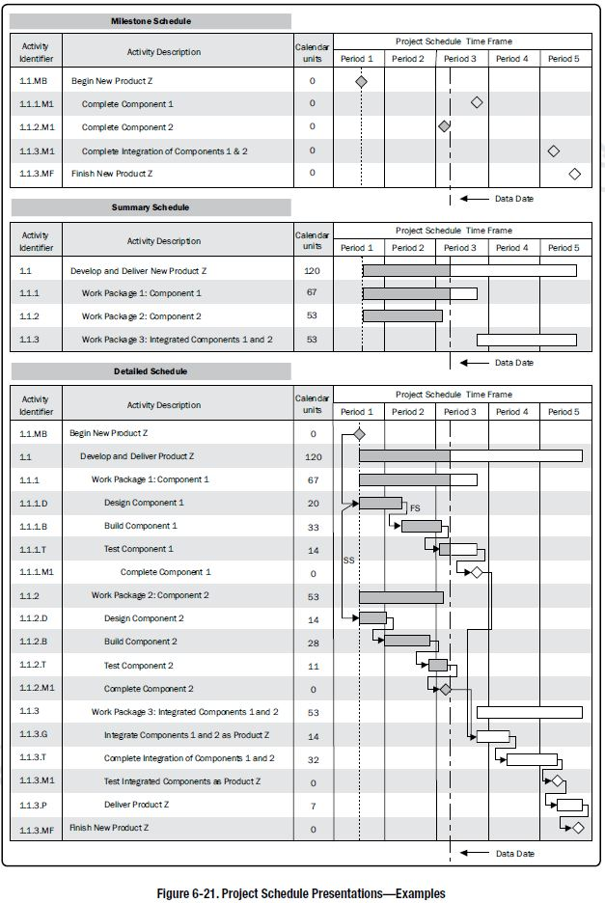
PMBOK Gantt Chart
Example
Note the 3 versions of Gantt Charts:
  Milestone Schedule
  Only milestones
  Summary Schedule
  Work Package level
  Detailed Schedule
  See next slide
Sourced from the PMBOK Guide, 6th Edition

Slide 32
PMBOK Gantt Chart – Detailed Chart
Also called Status Date
Detailed Schedule Notes
Use of WP’s and Activities
Use of arrow dependencies
More than just FS relationships
Alpha numeric WBS code
Use of a calendar period and calendar units
No resources mentioned on this particular chart
Use of data date (status date), shaded area could show planned work as of data date but if actual work done was on-schedule, the shaded area would be the same
Sourced from the PMBOK Guide, 6th Edition

Slide 33
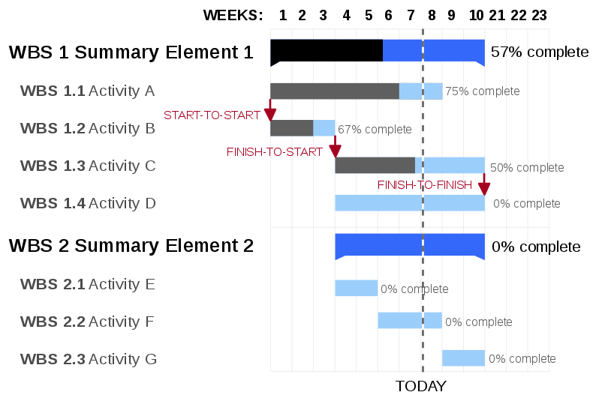
Other Gantt Chart Examples
Details for this chart:
Schedule is in weeks
Use of arrow dependencies
More than just FS relationships
Use of Today’s date, which is likely status date
Progress “% complete” is provided along with grey/black on bars
The blue part of the bar represents remaining work
No milestones are used
The project is “behind schedule”
Sourced from Wikipedia https://en.wikipedia.org/wiki/File:GanttChartAnatomy.svg

Slide 34
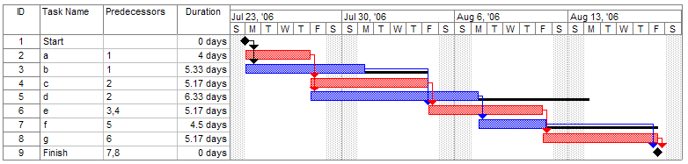
Other Gantt Chart Examples
Sourced from Wikipedia https://en.wikipedia.org/wiki/File:Pert_example_gantt_chart.gif
Details for this chart:
Schedule is in days
Use of arrow dependencies on the Gantt Chart
Only FS relationships
No status date or progress (“% complete”) provided
Critical path is shown in red
Slack is shown via horizontal black line, note activity “g” is NOT dependent on activity “f”, that’s why there is so much slack in activities “d” and “f”
Milestones are used for the Start and Finish

Slide 35
Resources from other textbooks or websites
Other Resources
PMP - Critical Path Method - Doing a Forward Pass - Part A
https://www.youtube.com/watch?annotation_id=annotation_327253&feature=iv&src_vid=mCXyUiexj0o&v=vxrcvE7bDY8
PMP - Critical Path Method / CPM Network Analysis- Doing a Backward Pass - Part B
https://www.youtube.com/watch?annotation_id=annotation_398679&feature=iv&src_vid=vxrcvE7bDY8&v=tT9KbnvRrTE
Developing a Basic Gantt Chart / Bar Chart Using Critical Path Method (CPM)
https://www.youtube.com/watch?v=mCXyUiexj0o

Slide 36
Summary
Critical Path Merge Bias and a Monte Carlo simulation
Understand the basics of Gantt Charts
Compare the similarities of Gantt Charts in Excel and MS Project

Slide 37
Homework
Refer to the Start Here section of this module
Study for midterm exam
  Modules to date
  Midterm review doc on FOL in Module 7
Review PPT files with solutions
Assignments, practice quizzes and graded quizzes, check the Course at a Glance and FOL/Content/Course Assignments & FOL/Evaluations/Quizzes
After the midterm exam
Read for the module after the midterm
  Kerzner 12th Ed p N/A, 11th p. 638-640
  PMBOK 6th Ed 6.5, 5th 6.6

Slide 38


